Slide 1

Get Real: a way to improve real estate
Hackrague 2021, ImpactHub
Powered by
October 17th, 2021

Slide 2


We are a team with a diverse skillset
that go/went to high school at malá strana
Small
Side
Devs
Marek Szeles
Concept Designer & Business Analysis
Tran Duc Thien
Data Scraper & Python dev
Filip Vopálenský
Data Scraper, API design

Slide 3


User story
Mirek is a guy looking to find a place to live, but it proves more difficult than expected

Slide 4
In the medium term, we need some 200,000 additional apartments
Berlin Housing Senator Sebastian Scheel

Slide 5
Problem
problem
When did Real Estate...
...become such a Real MESS state?

Slide 6

We cannot solve the market... ...but we can help individuals

Slide 7
Our solution – Get real
AI-powered
Real Estate dashboard and recommender
Data analytics-

Slide 8
use-case model
Current model
Problems:
Overwhelming information from many sources
High real estate turnover
Not knowing the right market prices
(young) people struggle to find the place to live they like
Trying to work out issue alone on many sites that offer the same service
Have to settle for someplace expensive that they do not like
Our model
People want to find the place to live
Input their priorities
Comparison to a large historical dataset
Strategic smart recommendation and best practices

Slide 9








architecture
API calls and data sources
Web Application
Prepares data for map visualis
Backend
Frontend
Potentially: AI recommender
Submits historical data for AI predictions

Slide 10
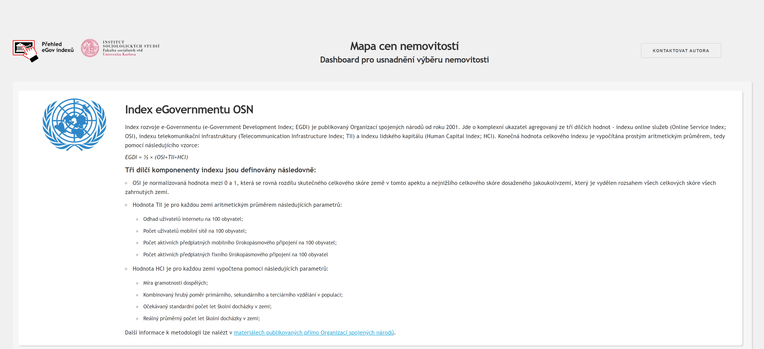
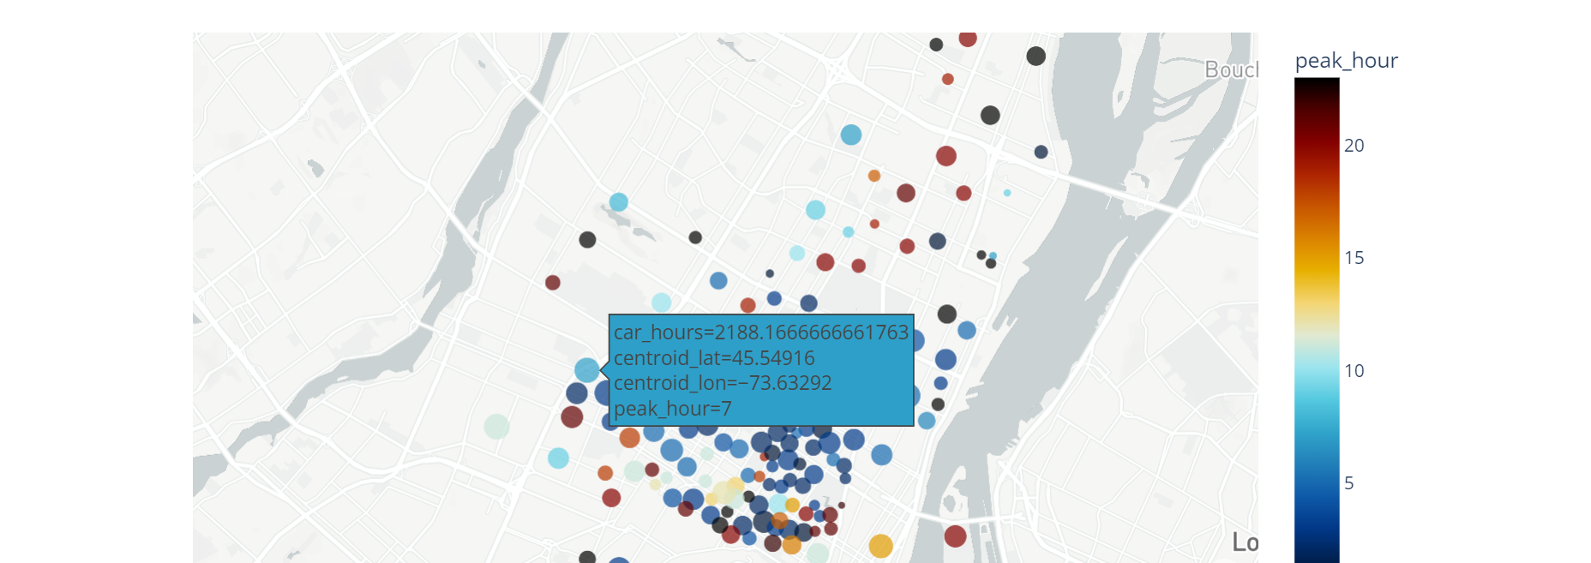

Demo
GetReal
See code on

Slide 11
Next steps and future of project
Improve User Interface
Add more datasets
Implement AI recommender

Slide 12
Possible monetization
Individuals
After trial, pay subscription fee for:
New real estate alerts,
AI recommendation for price competitions
Investors
Pay for SaaS AI recommender powered real estate portfolio management dashboard
Companies
Pay for access to data to improve their digital services based around Real Estate

Slide 13
Summary recap
We identified the issues faced by people in real estate…
…Enabled them to see all the data on the market…
…and GetReal is the dashboard that helps them make better decisions

Slide 14
GetReal
Thank you.
Let‘s get real together!

Slide 15
datasets already used (Flatzone)

Slide 16
datasets already used (Apify)

